Slide 1

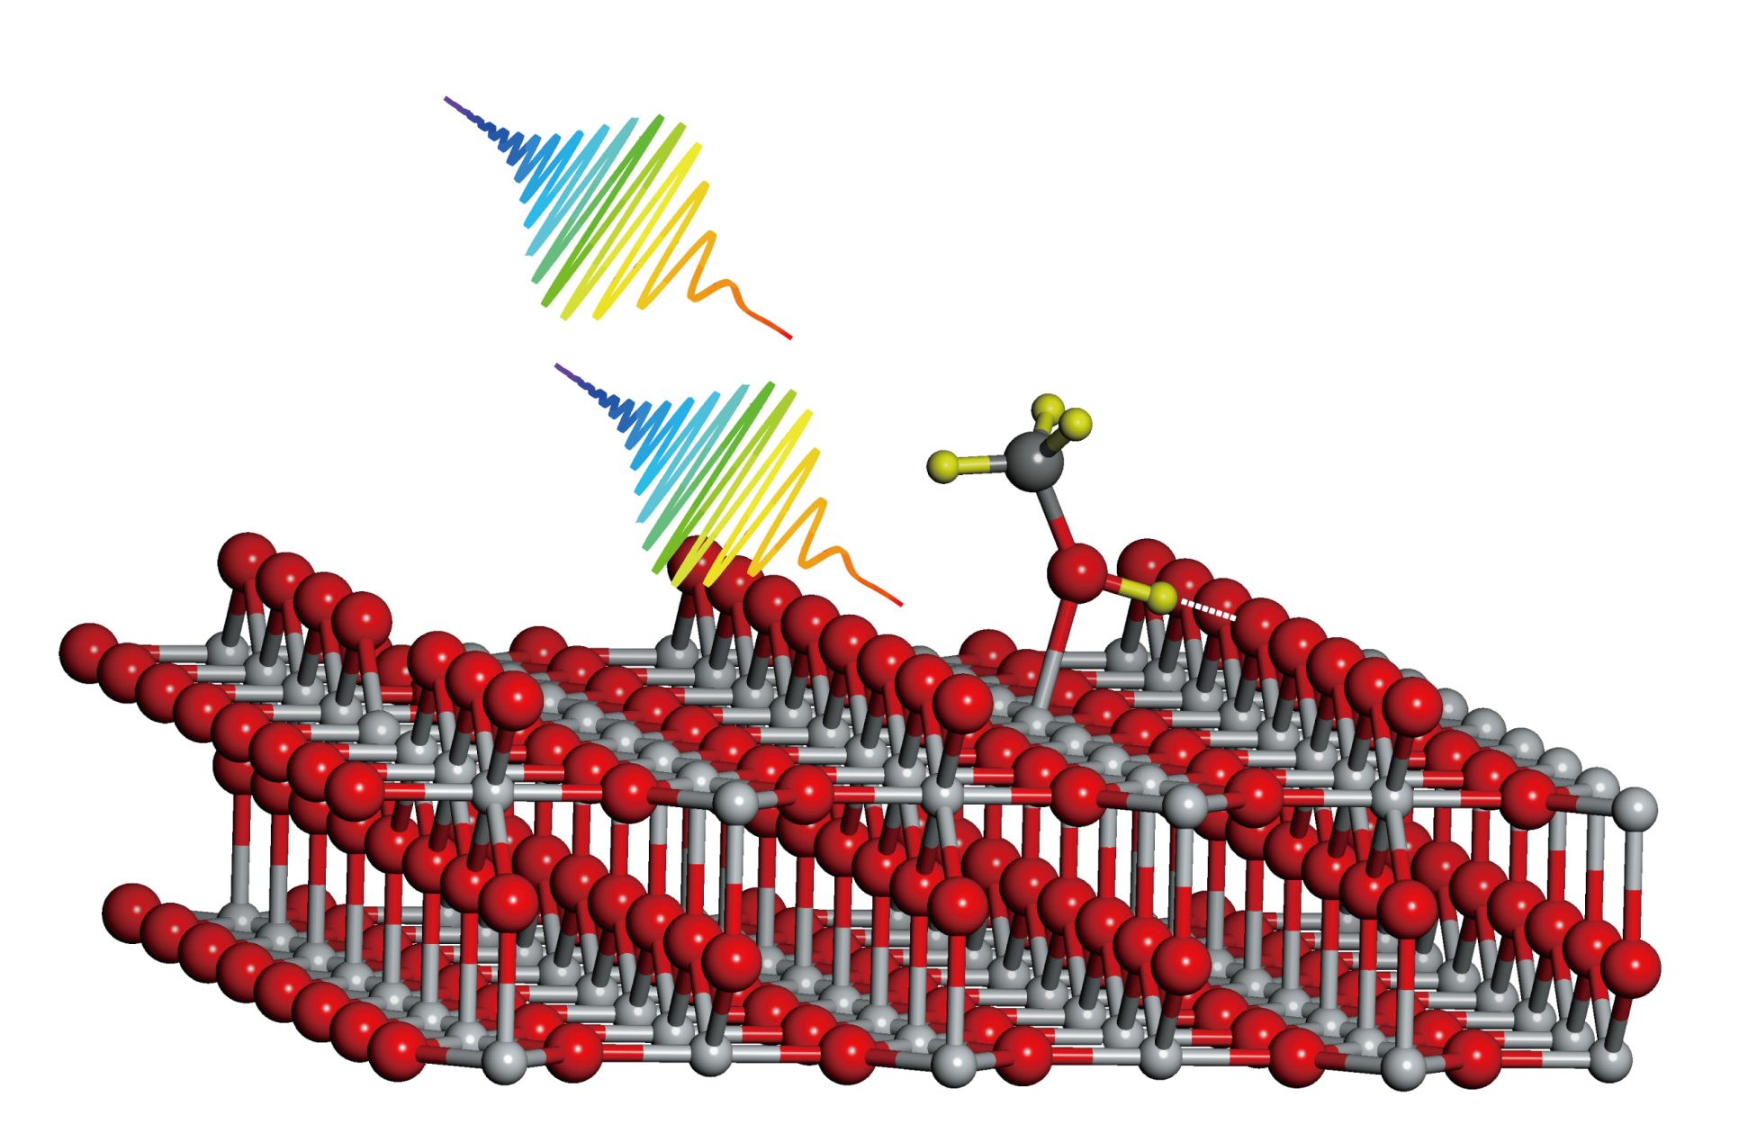
Ultrafast Surface Dynamics
表面物理课程
之
任泽峰
International Center for Quantum Materials

Slide 2
个人简介
北京大学国际量子材料科学中心研究员，副教授，博士生导师
2000.9—2004.7 中国科技大学化学物理系 学士
2004.9—2009.8 中科院大连化学物理研究所 博士
2009.9—2011.2 德国马普学会Fritz-Haber研究所 洪堡学者博士后
2011年2月 北京大学量子材料科学中心 研究员，副教授
发表论文10余篇，其中2篇Science, 1篇PNAS, 2篇Chem. Sci., 1篇JACS。获中科院院长特别奖（2009年）和优秀奖（2007年），国家自然科学奖二等奖（2008年），辽宁省自然科学一等奖（2007）等。研究工作曾在2006年，2007年两次被评为中国十大科技进展之一。兴趣: 利用超快光谱和电子谱技术研究表面光催化, 表面电子等动力学过程, 发展其他超快的研究手段.

Slide 3
Outline
Introduction:
What is dynamics? Why ultrafast?
Surface Dynamics Methods:
Optical Excitation on surfaces: 2PC for example
Time-resolved Two-Photon Photoemission Spectroscopy
Time-resolved Surface Nonlinear Spectroscopy
Time-resolved Ultrafast Electron Diffraction/Microscopy
Perspective

Slide 4
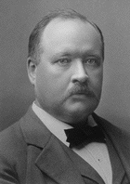
Barrier Height (E_{a} ) Controls Chemical Reaction Rates
k = A exp(-E_{a}/kT)
E_{a}
Arrhenius
E_{a’}
R
P
The concept of transition state (TS) is crucial for the understanding of chemical reactivity.
Henry Eyring
1930’s

Slide 5
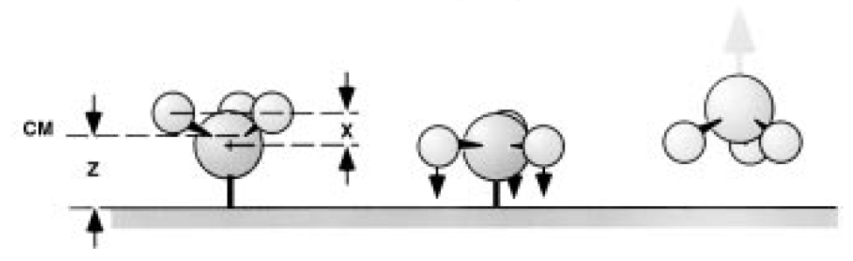
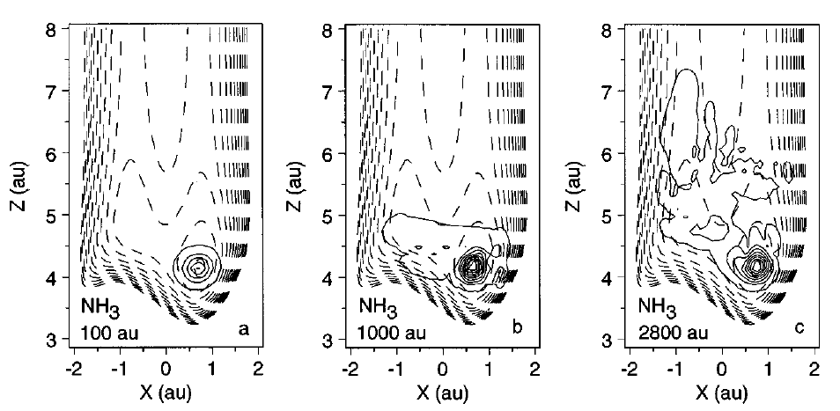
Photostimulated Desorption of NH₃ from Cu(111)
G. Ertl et al., JCP, 102, 3414(1995)
H. Guo et al., JCP, 104, 8757(1996)

Slide 6


What is Dynamics?
Dynamics
Structure
Kinetics
A fast camera is enough !!!

Slide 7
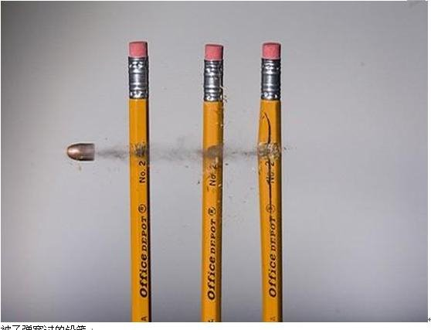
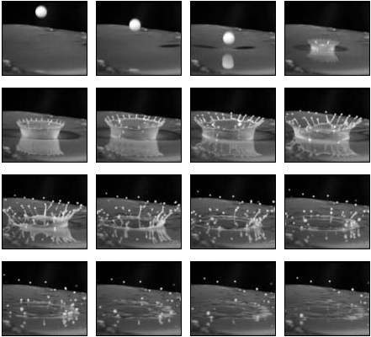
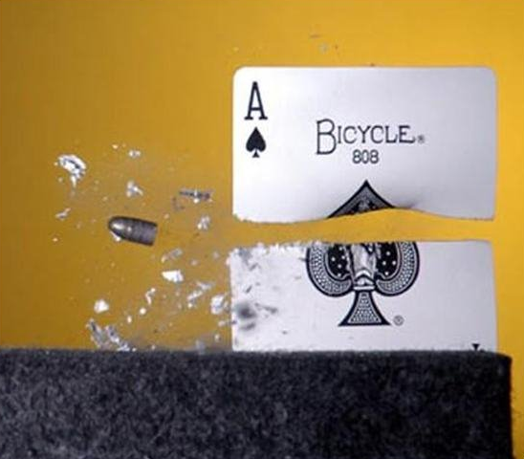
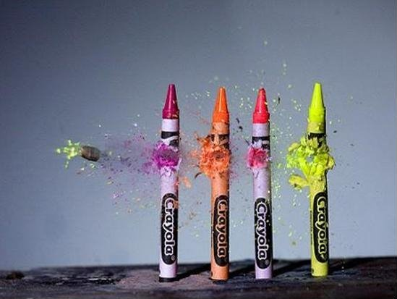
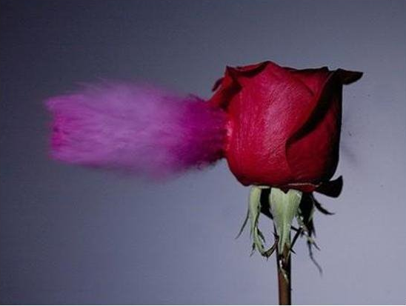

Slide 8
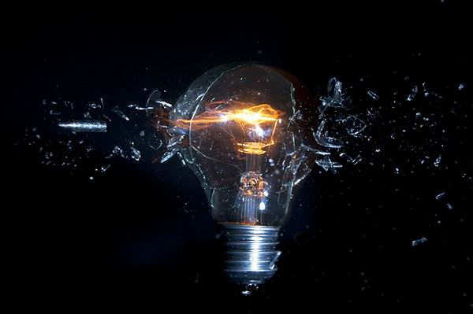
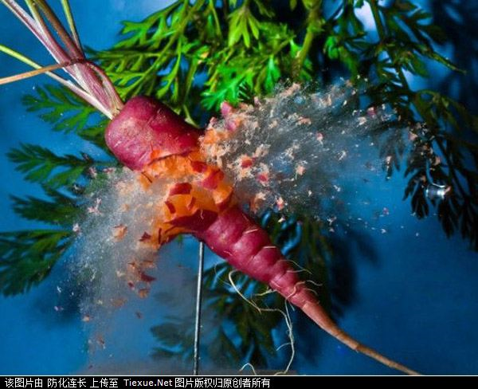
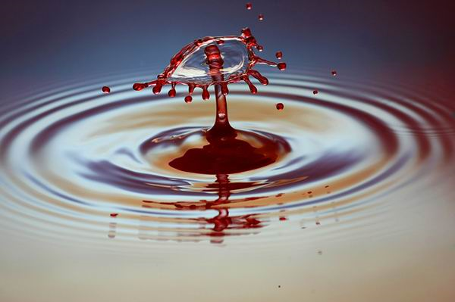
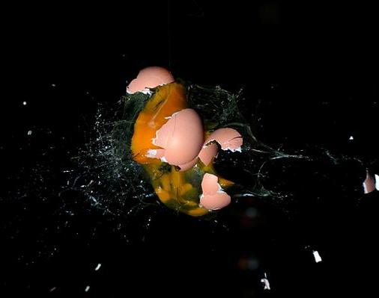

Slide 9
Outline
Introduction:
What is dynamics? Why ultrafast?
Surface Dynamics Methods:
Optical Excitation on surfaces: 2PC for example
Time-resolved Two-Photon Photoemission Spectroscopy
Time-resolved Surface Nonlinear Spectroscopy
Time-resolved Ultrafast Electron Diffraction/Microscopy
Perspective

Slide 10
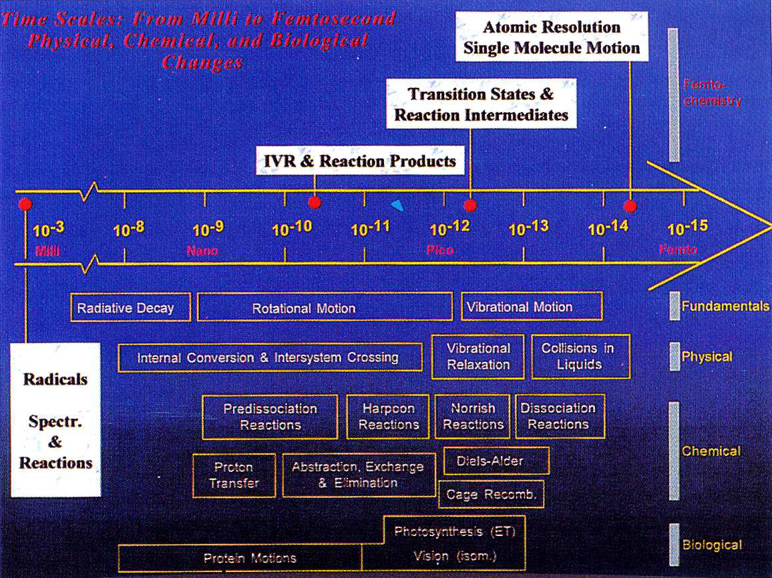

Slide 11
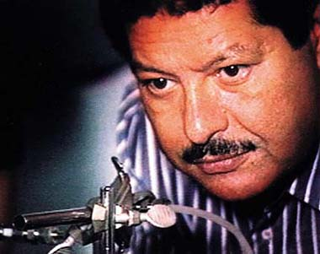
Femtochemistry
A.H. Zewail
1999 Nobel Prize in Chemistry

Slide 12
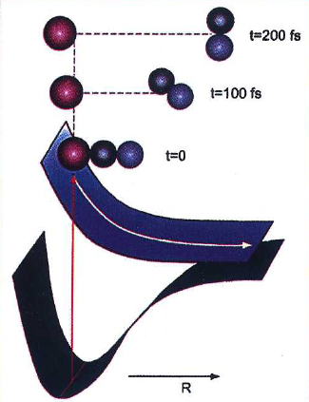
Why femtosecond?
V=1000 m /s
3 Å / 1000 m/s = 300 fs

Slide 13
attosecond 10⁻¹⁸
electron
dynamics

Slide 14
The First Femtochemistry Exp.
I + CN*
probe
I + CN
pump
Intensity
ICN → I + CN
Delay t

Slide 15
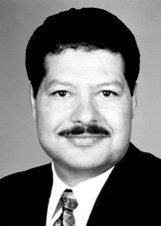
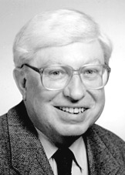
Marriage Between Surface Science
& Femtosecond Laser
—— to investigate the surface dynamics
Ahmed Zewail
Gerhard Ertl
飞秒化学
表面化学
飞秒时间尺度
原子分子尺度

Slide 16
Outline
Introduction:
What is dynamics? Why ultrafast?
Surface Dynamics Methods:
Optical Excitation on surfaces: 2PC for example
Time-resolved Two-Photon Photoemission Spectroscopy
Time-resolved Surface Nonlinear Spectroscopy
Time-resolved Ultrafast Electron Diffraction/Microscopy
Perspective

Slide 17
Optical Excitation on surfaces
Mechanism and timescales of energy transfer after optical excitation.
metal
Photoabsorption in a metal substrate creates a transient non-equilibrium electron distribution
Energy transfer to phonons and adsorbate vibrational excitation
Primary step: Electron thermalization and cooling

Slide 18
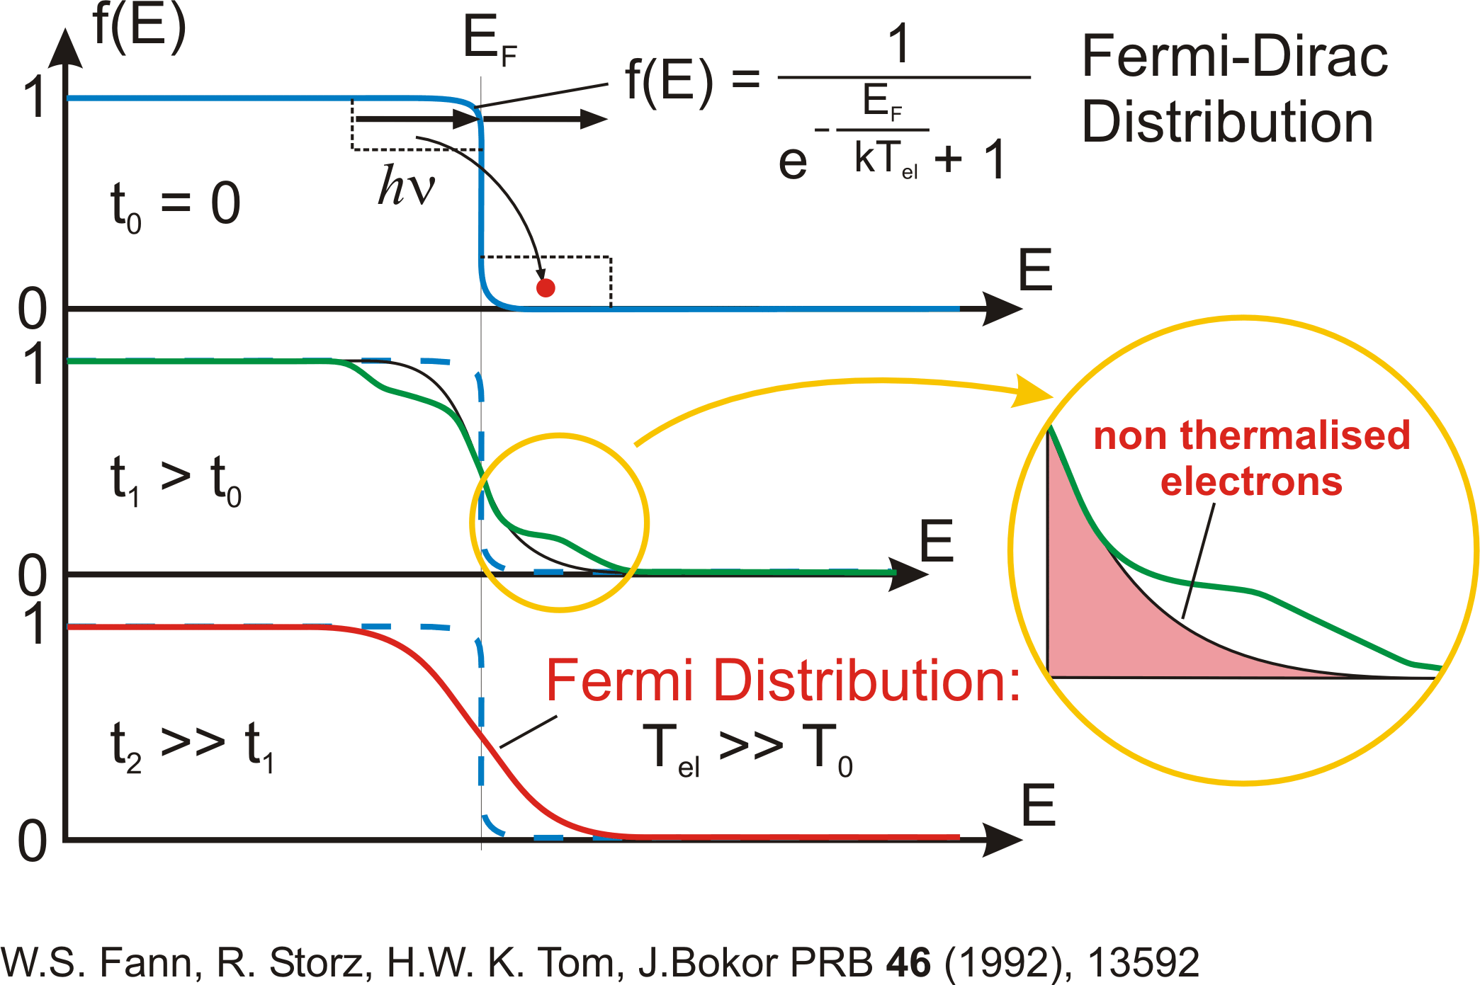
Electron thermalization dynamics in metals

Slide 19
Reaction Mechanism
How to distinguish?

Slide 20
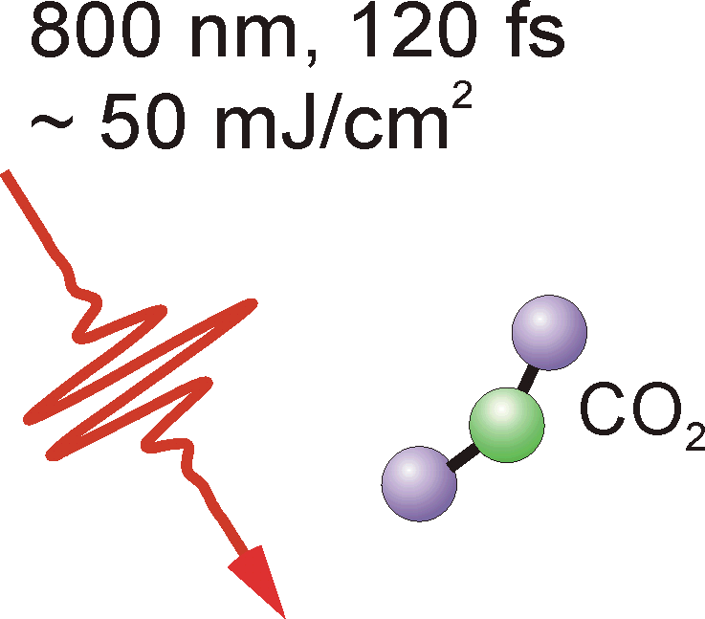
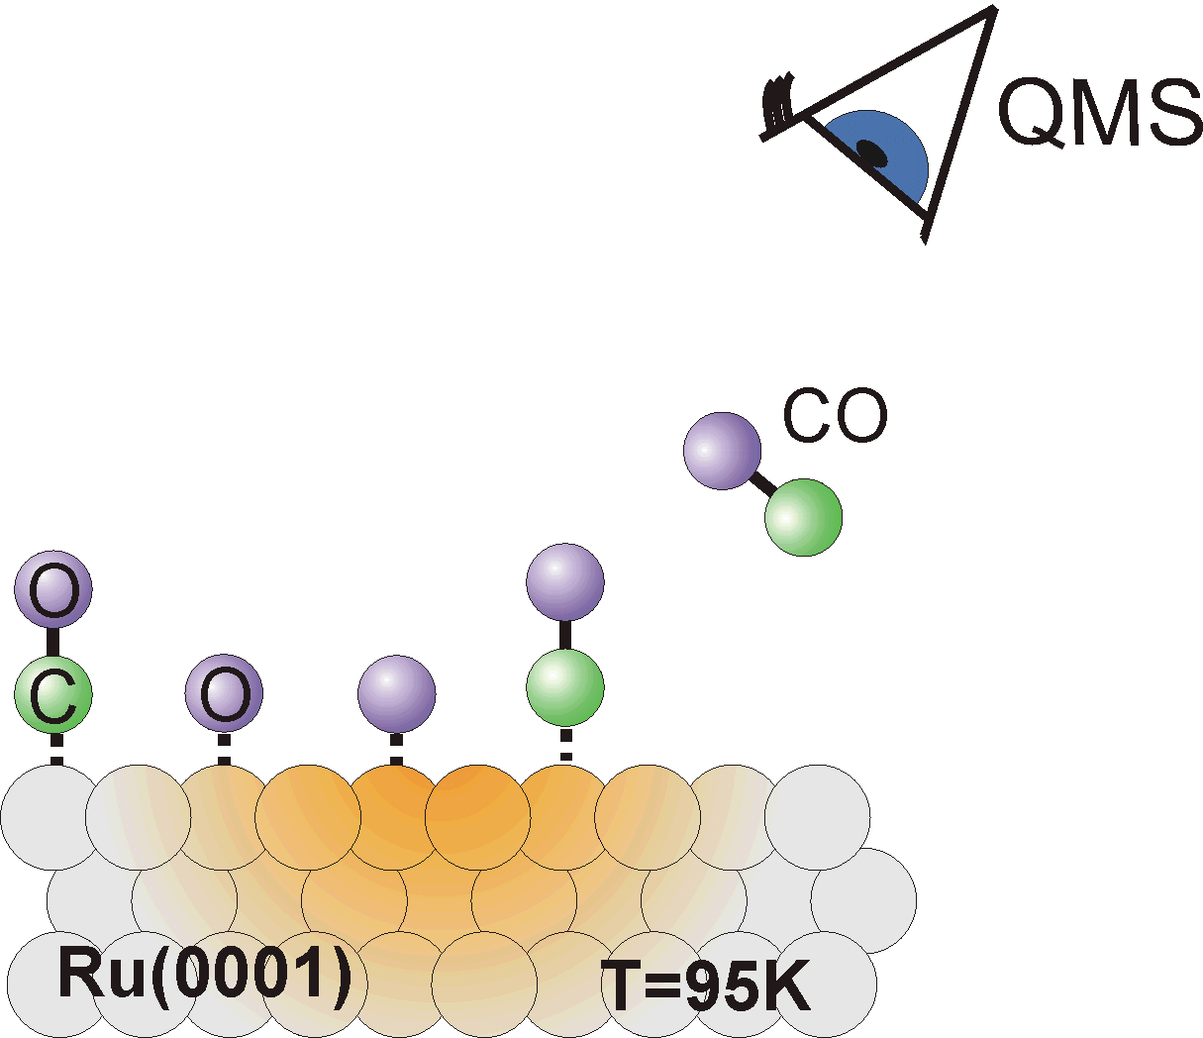

Example: Oxidation of CO on Ru(0001)
fs-induced reaction pathways
CO₂ formation
E_{trans} =
1590 K
Flux [arb. units]
CO desorption
E_{trans} =
640 K
0
5
0
1
0
0
1
5
0
0
0
TOF / us
New reaction pathway is „switched on“ upon fs excitation
M. Bonn, et al., Science 285, 1042 (1999)

Slide 21
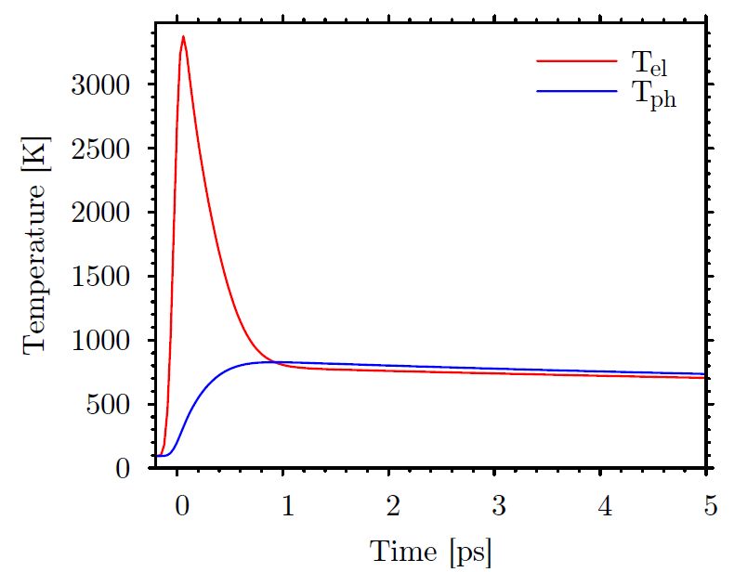
2-Pulse Correlation Measurements
electronic friction model
*
*
Maximal electronic temp (K)
*
Maximal electronic temp (K)
Maximal electronic temp (K)
Maximal electronic temp (K)
Maximal electronic temp (K)
Maximal electronic temp (K)
Maximal electronic temp (K)
Maximal electronic temp (K)
*
*
*
-2 -1 1
0
2
-2 -1 1
-2 -1 1
0
0
2
-2 -1 1
2
0
2
-2 -1 1
0
2
-2 -1 1
-2 -1 1
-2 -1 1
0
0
0
2
2
2
delay (ps)
delay (ps)
delay (ps)
delay (ps)
delay (ps)
delay (ps)
delay (ps)
delay (ps)

Slide 22
2-Pulse Correlation Measurements

Slide 23
DFT Calculation

Slide 24
Reaction pathways
for thermal versus femtosecond excitation
Separation of time scales opens new reaction pathway

Slide 25
Outline
Introduction:
What is dynamics? Why ultrafast?
Surface Dynamics Methods:
Optical Excitation on surfaces: 2PC for example
Time-resolved Two-Photon Photoemission Spectroscopy
Time-resolved Surface Nonlinear Spectroscopy
Time-resolved Ultrafast Electron Diffraction/Microscopy
Perspective

Slide 26
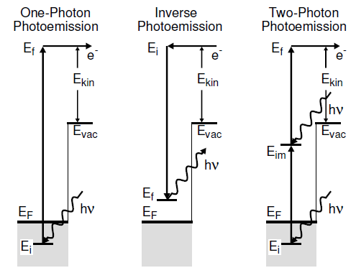
Two-photon Photoemission Spectroscopy
(2PPE) — Probe Unoccupied States
UPS, XPS

Slide 27
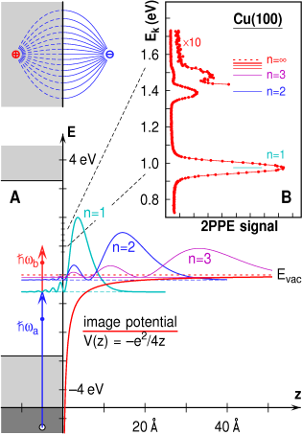
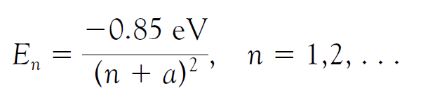
Image Potential States on Cu(100)
Höfer et al., Science, 277, 1480(1997)

Slide 28
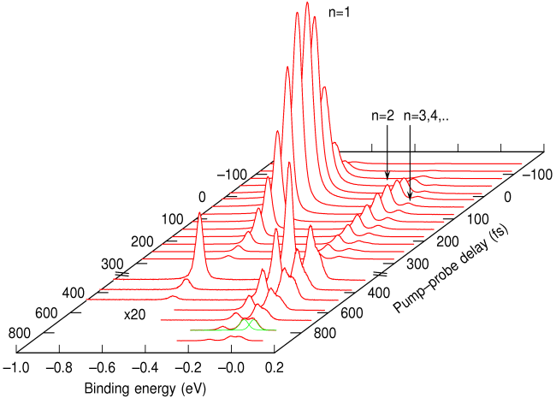
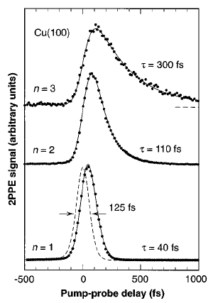
Time-resolved 2PPE:
Image Potential States on Cu(100)
Höfer et al., Science, 277, 1480(1997)

Slide 29
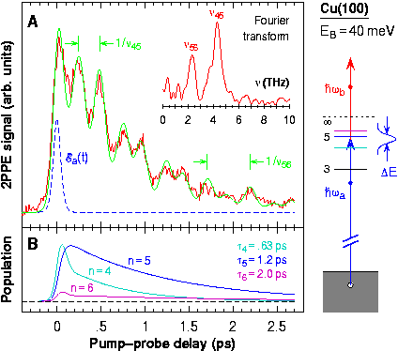
Quantum Beats
Höfer et al., Science, 277, 1480(1997)

Slide 30
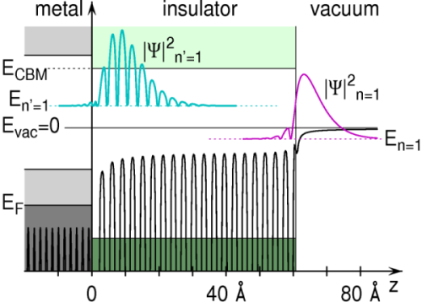
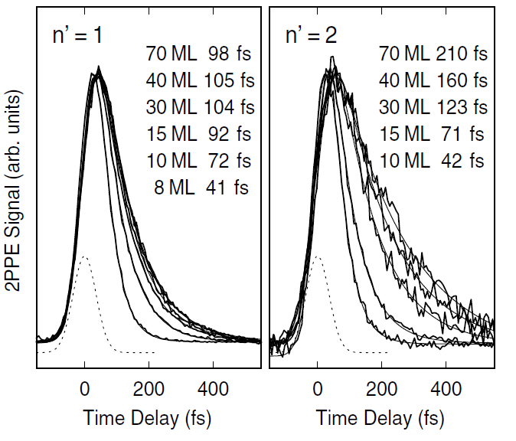
Interface States at a Metal-Rare Gas Boundary
Cu(100)
20ML Ar
Höfer et al., PRL, 94, 17401(2005)

Slide 31
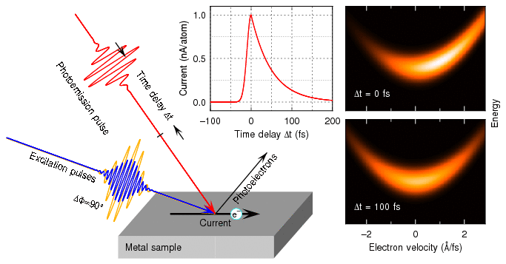
TR-2PPE + ARPES
From Höfer homepage (Science, 318, 1288(2007))

Slide 32
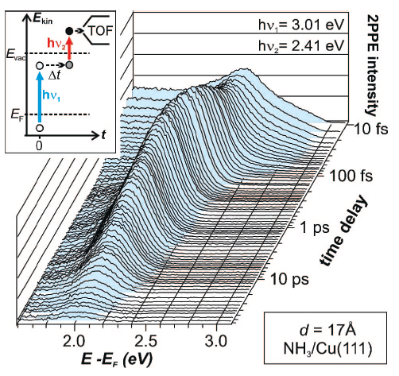
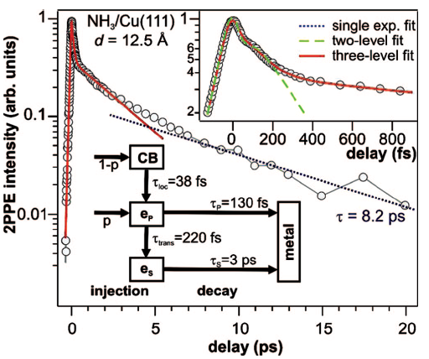
Ultrafast Electron Transfer Dynamics at NH₃/Cu(111) Interface
J. Stähler et al., JACS, 130, 8797(2008)

Slide 33
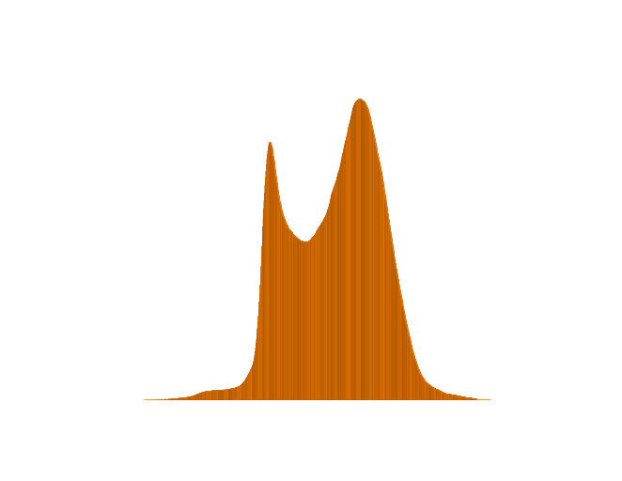


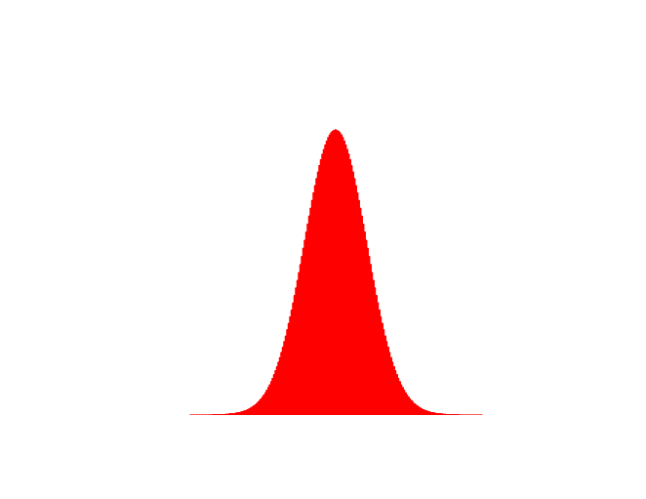
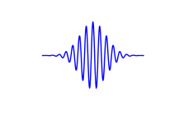
2PPE on TiO₂(110) @DICP
E-E_{F}
Final State
Vacuum Level
2PPE
φ
BC
E_{F}
Band Gap
3.05 eV
Defect states
hν=3.1 eV
VC
TiO₂
CH₃OH
Vacuum
Notes:
We employed 2PPE to study photochemistry on TiO2(110). 2PPE stands for …
This is the principle of the 2PPE on TiO2(110). In our study, we use 400nm light. The first photon excites electrons from the defect state to above the fermi level, and then the second photon excites the electron from the intermediate state to above the vacuum level, the energy and angular distribution were then analyzed and recorded to get the 2pp spectra.

Slide 34
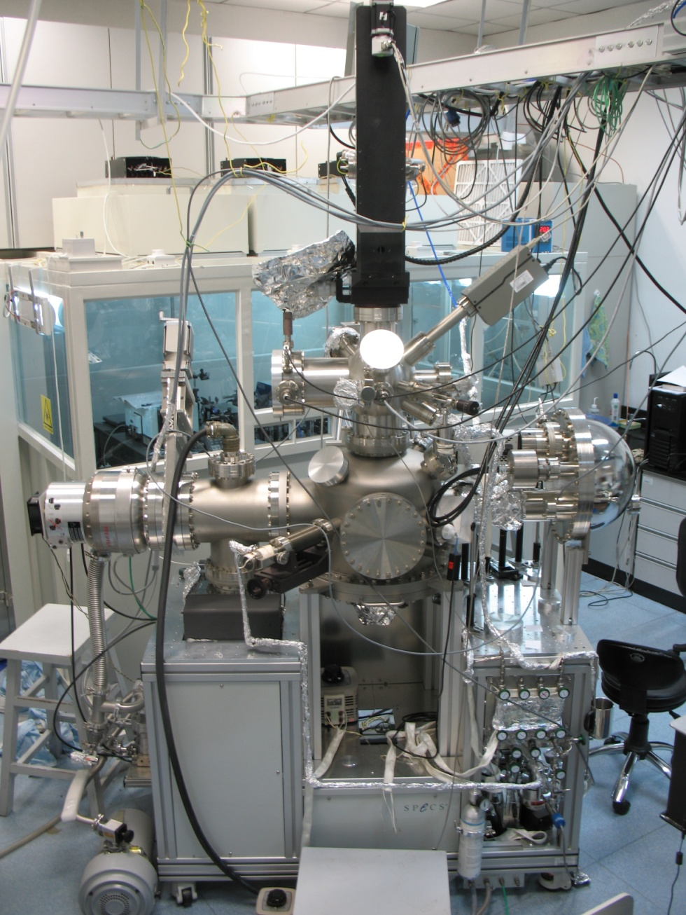
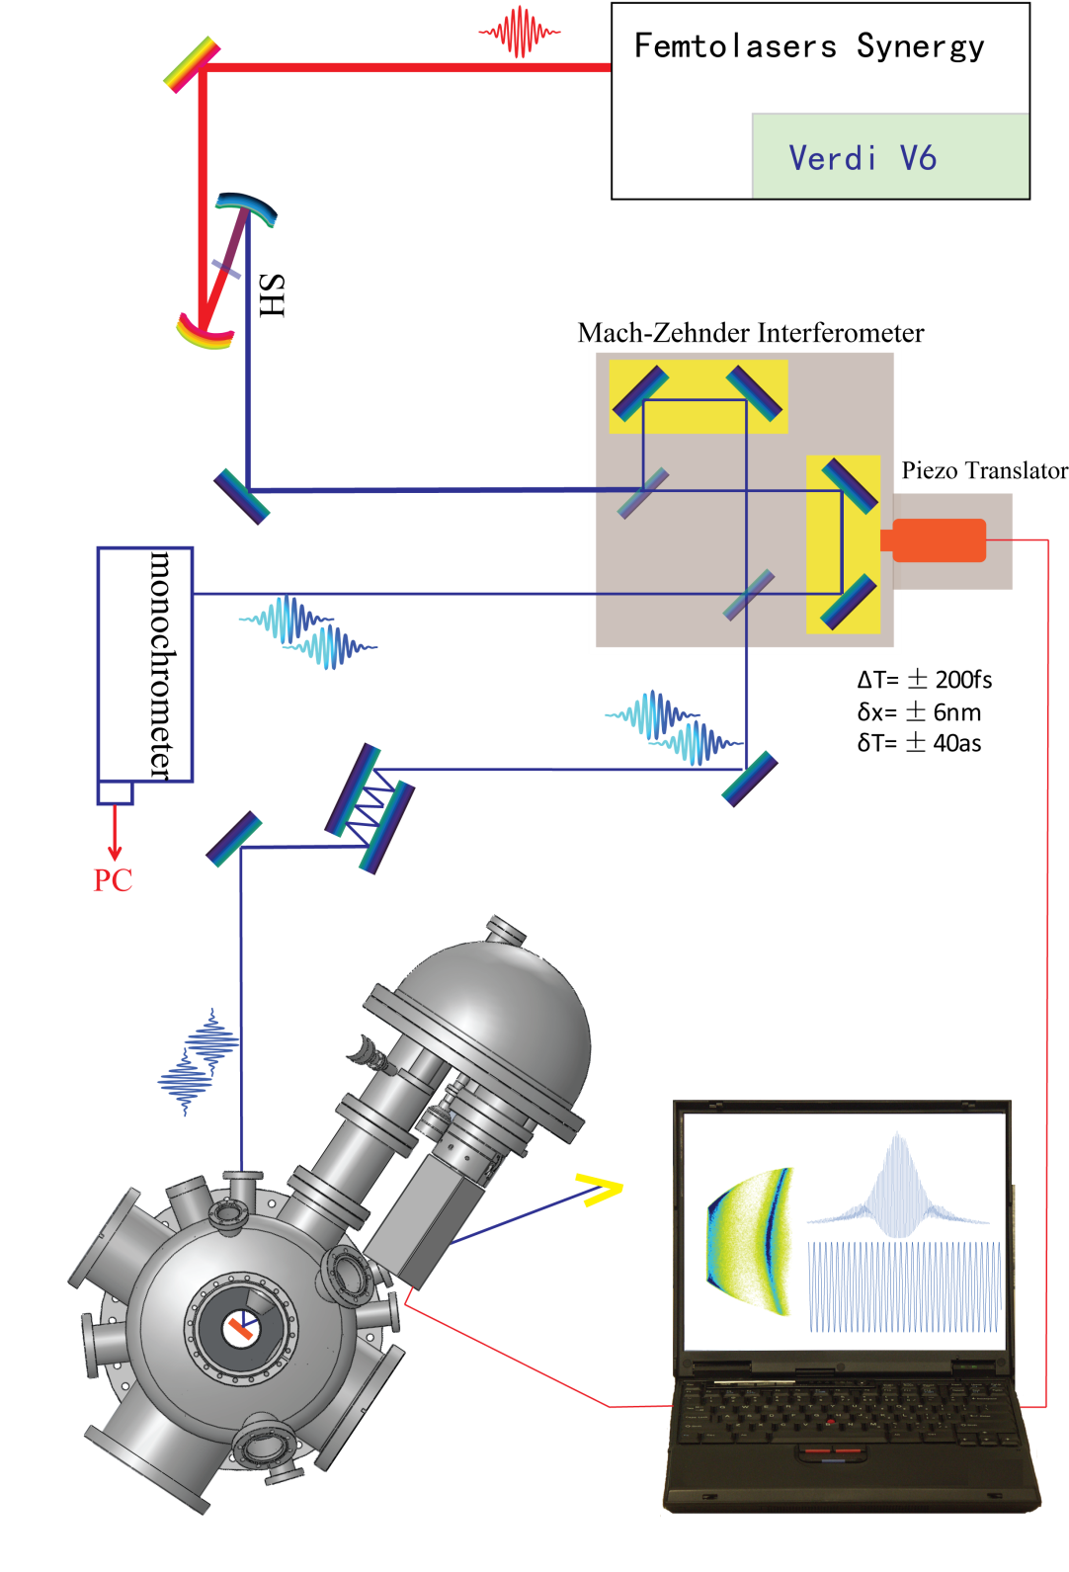
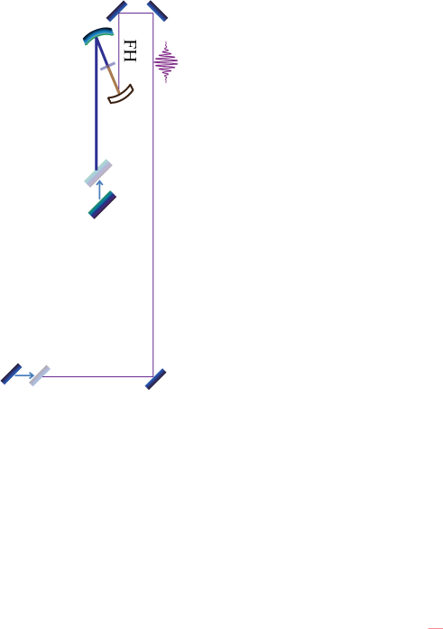

2PPE Setup in DICP
Notes:
This is the picture of our setup.
This is clean room, where the laser system is put.
This is UHV chamber, which has normal surface science tools, LEED, AES, ion gun. This hemisphere analyzer is used to measure the photoelectron spectra.
2D-detector in this hemisphere analyzer.

Slide 35
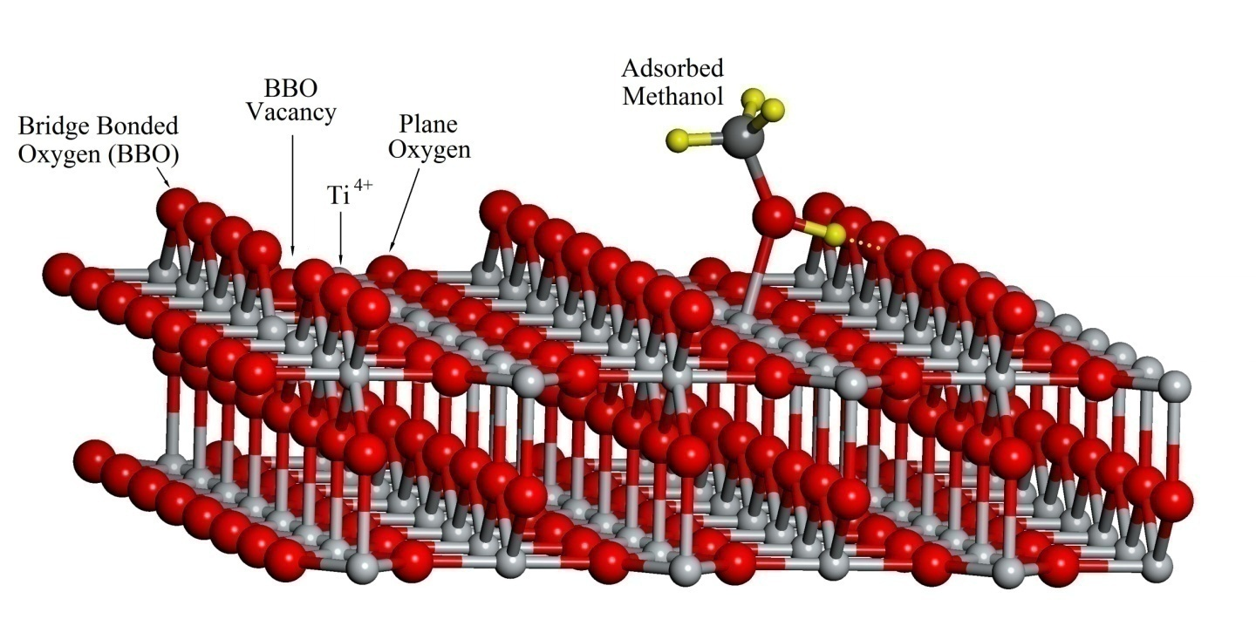
The Structure of TiO₂(110)
Notes:
This is the structure of TiO2(110), which is thermodynamically lowest energy surface.
BBOv commonly exists under UHV annealing.
The adsorbed methanol molecule prefers forming hydrogen bond to reduce the energy.

Slide 36
2PPE Spectra on o-TiO₂(110)
(Laser Irradiation Time of about 15 min.)
1 ML CH₃OH
Notes:
We also tried this experiment with 2PPE method. This is our result on oxidized surface.
This is final state energy, intermediate state energy, and the 2PPE signal.
The black curve is …,the green …, the red ….
We reproduced the phenomenon in the literature. However, these spectra was acquired after laser irradiation for 15min. One may ask what happen during the laser irradiation.

Slide 37
Time-Dependent 2PPE for the 1 ML CH₃OH/TiO₂(110)
Chemical Science, 1, 575 (2010).
Notes:
Here I show the time-dependent 2PPE results.
This is final state energy, this is the laser shinning duration. We can find this resonance signal is increasing as the laser irradiation time. At the fresh surface, no any resonance signal. We can also find the peak is shifting to the lower energy as the laser shinning.
We replaced methanol with other alcohols, and saw the similar phenomena. While, for dimethyl ether, which does not have OH group, we did not observe the resonance signal during a long period of laser irradiation.
So we can conclude that the resonance state is photoinduced. But only with 2PPE, we can not give the picture what happen when the surface is shined by light. To clarify this problem, we cooperative with STM from USTC.

Slide 38
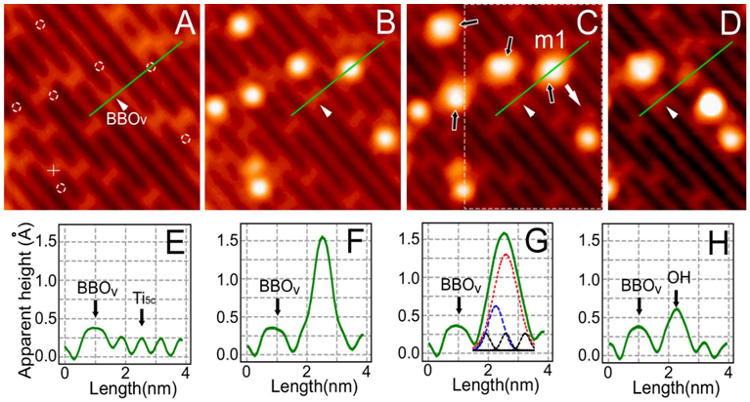
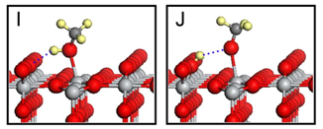
STM Results
S. Tan, B. Wang, J. Yang, J. Hou (USTC)
Notes:
This is the STM image of the bare surface. The bright line is the Ti row, the dark line is BBO row. These bright spots on the dark lines are BBOv.
Dose some methanol, most of them adsorb on the Ti sites and appear as round spots. 80K
After 10 minutes UV light illumination, we can find the round spots became elongated.

Slide 39
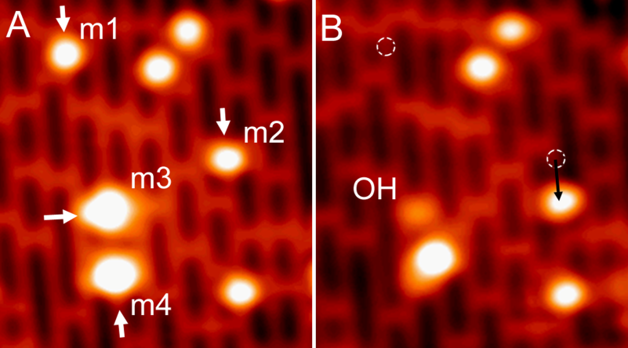
Manipulation of Methanol on 5c-Ti Sites
CB
e* + h = phonons
S. Tan, B. Wang, J. Yang, J. Hou (USTC)
Notes:
Our collaborators also performed the STM tip manipulation. This slide is clearer.
They push the round spot along the Ti row, the bright spot always move as a whole. M1….m2…..So we can say these molecules keep the molecular state after 10 min light irradiation.
Let’s push these stretched spots m3 and m4.
Push m4, the main group of the “stretched” methanol molecule was removed from the surface, while an OH species was left on the BBO row. Another case, push m3, the main bright spot was moved to here, and a less bright spot left on BBO sites. The position is right by the side of the surface Ti ion where the methanol resided previously. This less bright spot was proved to be a BBO-H. And this bright spot was assigned as a methoxy group.
So now we can conclude that

Slide 40
Photoinduced Dissociation of CH₃OH on TiO₂(110)
Notes:
This is the model.

Slide 41
Ultrafast Excited Electron Dynamics
1 ML CH₃OH on TiO₂(110)

Slide 42
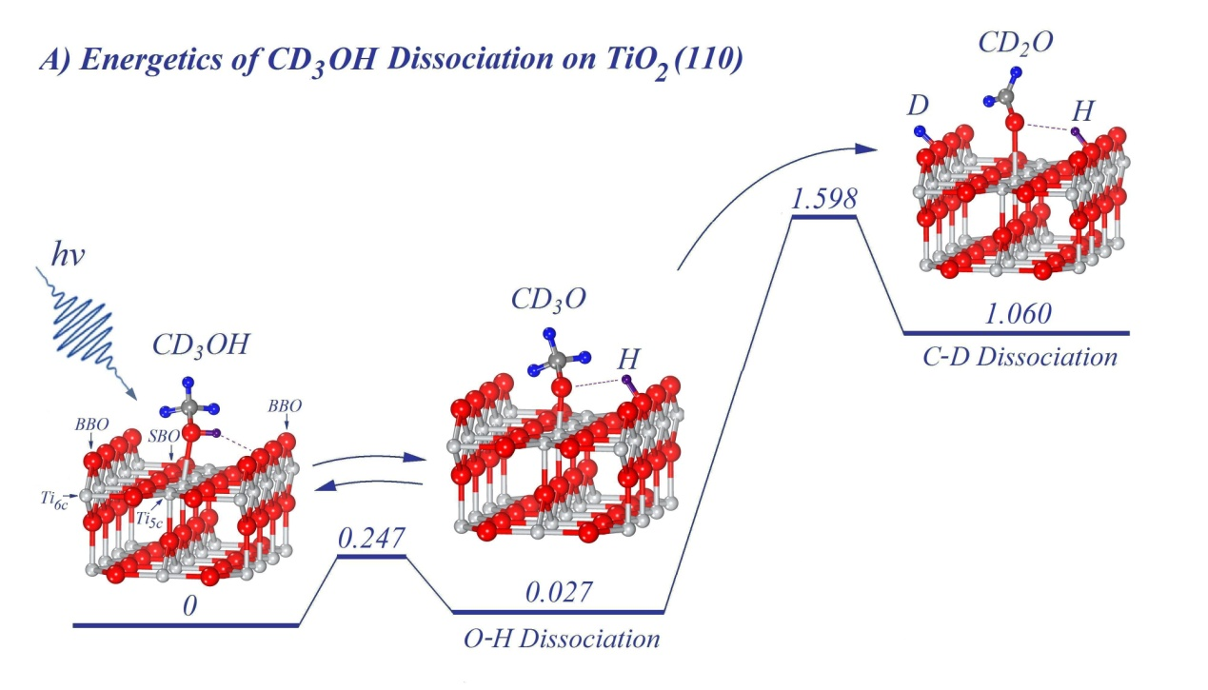
Stepwise Dissociation of CD₃OH on TiO₂(110)
JACS, 134, 13366(2012)

Slide 43
Outline
Introduction:
What is dynamics? Why ultrafast?
Surface Dynamics Methods:
Optical Excitation on surfaces: 2PC for example
Time-resolved Two-Photon Photoemission Spectroscopy
Time-resolved Surface Nonlinear Spectroscopy
Time-resolved Ultrafast Electron Diffraction/Microscopy
Perspective

Slide 44
Surface Nonlinear Optical Spectroscopy
Electric polarization
（macroscopic）
linear
second order
Induced
dipole moment
（microscopic）
SHG
SFG
DFG

Slide 45
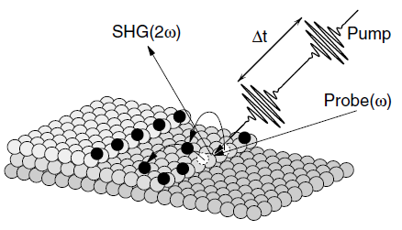
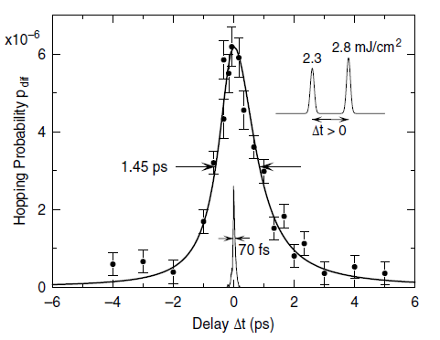
Time-Resolved Measurement of Surface Diffusion
O/Pt(111)
Höfer et al., PRL 94, 236103 (2005)

Slide 46
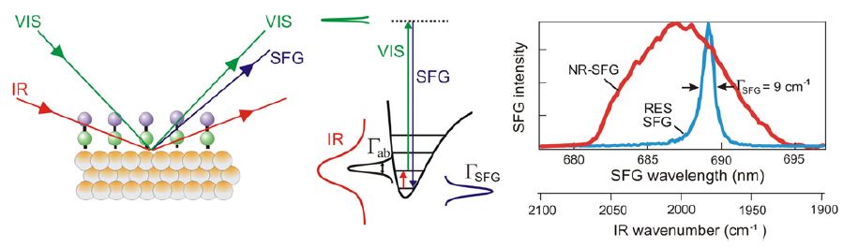
宽带红外-表面和频振动光谱原理
Broad Band Sum Frequency Generation （ BB-SFG）
Advantages:
1.Surface/interface Selective
2.Femtosecond Time Resolved

Slide 47
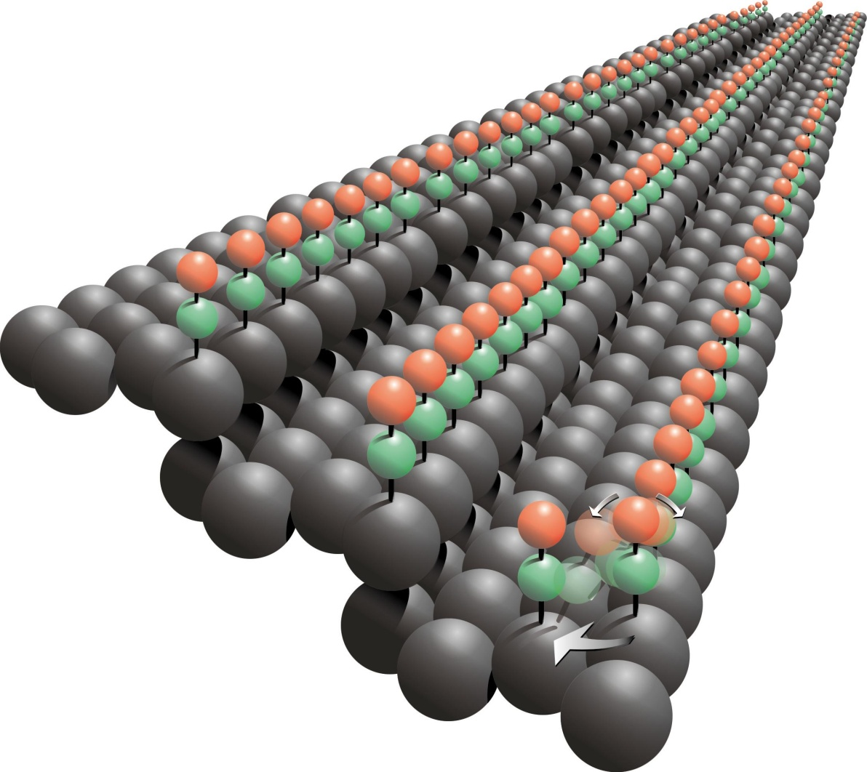
TR-SFG example: CO/Pt(533)
Real-Time Observation of Molecular Motion on a Surface
M. Bonn, et al., Science 310 , 1790 (2005)

Slide 48
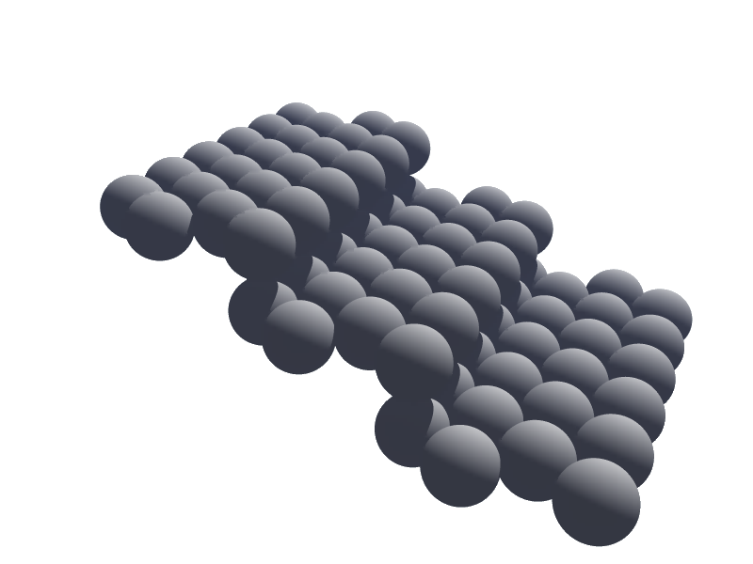
Site-dependent Vibrational Frequency
Step E_{bind}~2 eV
step CO
θ=0.25 ML
Pt(533)
Terrace
E_{bind}~1.5 eV
terrace CO
θ=1 ML
SFG Intensity (a.u.)
7Å
2000
2050
2100
2150
2200
IR frequency (cm⁻¹)

Slide 49
Time-resolved Hopping
Steps
Terraces
step CO
75%
30%
terrace CO
-9.6 ps
without pump
-1.6 ps
SFG Intensity (a.u.)
-1.2 ps
delay
-0.8 ps
with pump
-10 ps
-0.4 ps
170 ps
0 ps
2000
2050
2100
2150
0.4 ps
IR frequency (cm⁻¹)
1900
2000
2100
2200
IR frequency (cm
-1
)
M. Bonn, et al., Science 310 , 1790 (2005)

Slide 50
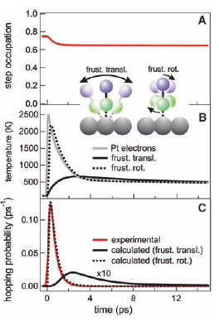
Real-Time Observation of Molecular Motion on a Surface
M. Bonn, et al., Science 310 , 1790 (2005)

Slide 51

DFT Calculation
Frustrated translation
Frustrated rotation
M. Bonn, et al., Science 310 , 1790 (2005)

Slide 52

Time-resolved Surface
Sum Frequency Generation (TR-SFG)

Slide 53
Outline
Introduction:
What is dynamics? Why ultrafast?
Surface Dynamics Methods:
Optical Excitation on surfaces: 2PC for example
Time-resolved Two-Photon Photoemission Spectroscopy
Time-resolved Surface Nonlinear Spectroscopy
Time-resolved Ultrafast Electron Diffraction/Microscopy
Perspective

Slide 54


Slide 55
Why Using Electrons ?
de Broglie's wave: λ=h/p
LEED: Low Energy Electron Diffraction
RHEED: Reflection High Energy Electron Diffraction
SEM, TEM: Scanning / Transmission Electron Microscopy
EELS: Electron Energy Loss Spectra
Spatial + Time = 4D
Simultaneous Spatial & Time Resolution
UED: Ultrafast Electron Diffraction
UEM: Ultrafast Electron Microscopy
UEELS: Ultrafast Electron Energy Loss Spectra
Spatial resolution

Slide 56





Principle of UEM

Slide 57

Femtosecond EELS
Zewail et al., Science, 325, 181(2009)

Slide 58

Time-resolved EELS
Zewail et al., Science, 325, 181(2009)

Slide 59


Ultrafast X-ray
Light Sources
Free Electron Laser

Slide 60

LINAC based femtosecond x-ray source
30 GeV
80 fs 10¹⁰, 30 GeV e-/pulse:
80 fs, 9 keV, 10⁶ x rays/pulse
Notes:
Photo of SLAC site including the 3km linac.
SPPS which ran until March used compressed ultrarelativistic electron beams from SLAC to produce short, 80fs, x-ray bursts. The experiment was used as a test bed for experiments and technology for 4th gen. x-ray FELs.
Upper left is a picture of the undulator, along w/ D. Fritz and S Lee working on electrooptic setup while D. Reis looks on…
FOCUS participation: D. Reis, D. Fritz, A. Cavalieri (now MPQ), S. Lee (now KRISS), P. Bucksbaum (MI)
S. Fahy (FOCUS fellow) & E. Murray Cork.
The experiment was decomissioned to make space for the LCLS x-ray FEL. FOCUS is involved in beamline and experimental design and we plan on conducting experiments at first light (2008).
In the mean time we were able to use SPPS for first studies ever detailed studies of femtosecond excited state dynamics in a solid with angstrom resolution….

Slide 61

Single-particle Coherent Diffractive Imaging
with an XFEL Pulse.
K J Gaffney, H N Chapman
Science 2007;316:1444-1448
Notes:
Schematic depiction of single-particle coherent diffractive imaging with an XFEL pulse. (A) The intensity pattern formed from the intense x-ray pulse (incident from left) scattering off the object is recorded on a pixellated detector. The pulse also photo-ionizes the sample. This leads to plasma formation and Coulomb explosion of the highly ionized particle, so only one diffraction pattern [a single two-dimensional (2D) view] can be recorded from the particle. Many individual diffraction patterns are recorded from single particles in a jet (traveling from top to bottom). The particles travel fast enough to clear the beam by the time the next pulse (and particle) arrives. The data must be read out from the detector just as quickly. (B) The full 3D diffraction data set is assembled from noisy diffraction patterns of identical particles in random and unknown orientations. Patterns are classified to group patterns of like orientation, averaged within the groups to increase signal to noise, oriented with respect to one another, and combined into a 3D reciprocal space. The image is then obtained by phase retrieval.

Slide 62
Outline
Introduction:
What is dynamics? Why ultrafast?
Surface Dynamics Methods:
Optical Excitation on surfaces: 2PC for example
Time-resolved Two-Photon Photoemission Spectroscopy
Time-resolved Surface Nonlinear Spectroscopy
Time-resolved Ultrafast Electron Diffraction/Microscopy
Perspective

Slide 63
Perspective:
Probe Surface Dynamics
Ultrafast Pulse of Light
Ultrafast Pulse of Electrons
Ultrafast Pulse of Atoms
Ultrafast Pulse of Neutron, Proton ?

